Slide 1
MINES-VIS
Week 4

Slide 2
Hough Transforms
Introduction
Using gradient information to detect lines
Representing a line
[m,b] presentation
[r,θ] presentation
Detection lines algorithm
Detecting Circles, see OpenCV sample

Slide 3
Hough Transforms
Introduction
The Hough transform is a feature extraction technique. It is used mostly for detecting lines, but can be extended to find circles and ellipses
The goal is to find the location of lines in images.
Hough transform can detect lines, circles and other structures if their parametric equation is known.
It can give robust detection under noise and partial occlusion.

Slide 4
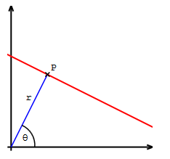

Hough Transforms
The general formula of a line is the well-known equation, where m denotes the slope, while b is the point where the line crosses the y-axis:
$$y=m.x+b$$
Although this is a simple and easy-to-use formula, vertical lines cannot be described with it. Now have a look at the following image:
Here a polar coordinate describes the line: r is the distance of the origin and the line, while θ is the angle of the vector pointing from the pole to the closest P point of the line. Using these notations, the equation of the line becomes the following, see next slide:

Slide 5
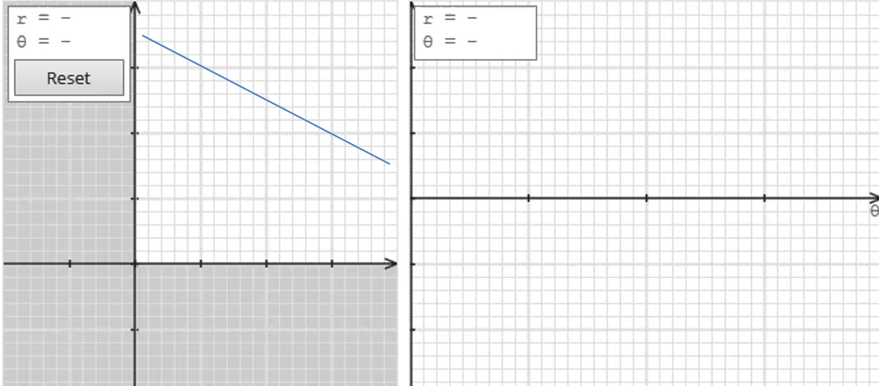



Hough Transforms
$$y=\frac{cos⁡(θ)}{sin⁡(θ)}x+\frac{r}{sin⁡(θ)}$$
Which can be rearranged to:
$$r=x.\cos\left(θ\right)+y.sin⁡(θ)$$
Suppose, that we have an arbitrary P point on an image. To get all possible lines going through it, simply rotate a line crossing P from 0 to 180 degrees: as θ changes r will change too.
$$P$$

Slide 6
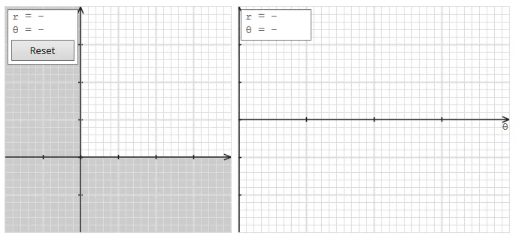
Hough Transforms
Here you see a line rotating around, while on the right panel the corresponding θ and r coordinates will be visualized. The result is sinusoidal.
The two trajectory cross each other, when the two points are on the same line. The θ and r coordinates of the crossing point exactly describe the line on which both points are found.
This is the basic idea of the Hough transform: we draw the sinusoid for each edge point, and then find the crossings, which describe the lines. Of course the more point is located on a line, the more sinusoid will cross at the given θ and r pair.

Slide 7
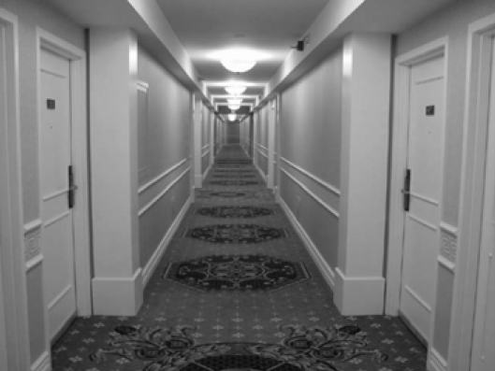
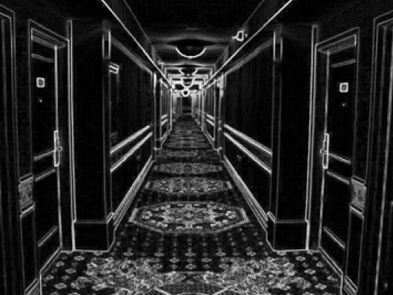
Hough Transforms
Image with linear structures
Borders between the regions are straight lines.
These lines separate regions with different grey levels.
Edge detection is often used as pre processing to Hough transform.

Slide 8
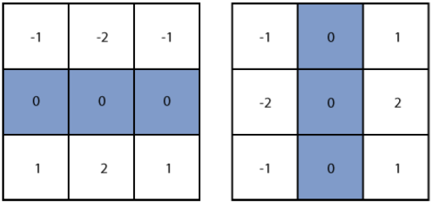
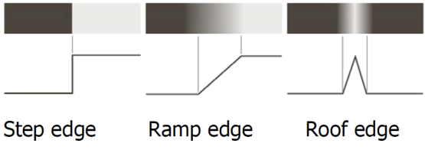

Hough-transform – the input
The input image must be a thresholded edge image.
The magnitude results computed by the Sobel operator can be thresholded and used as input.
Following a recap..
Sobel kernels $H_{x}{ and H}_{y}$

Slide 9
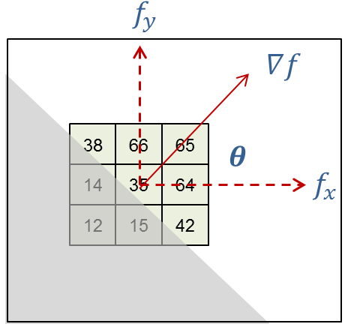
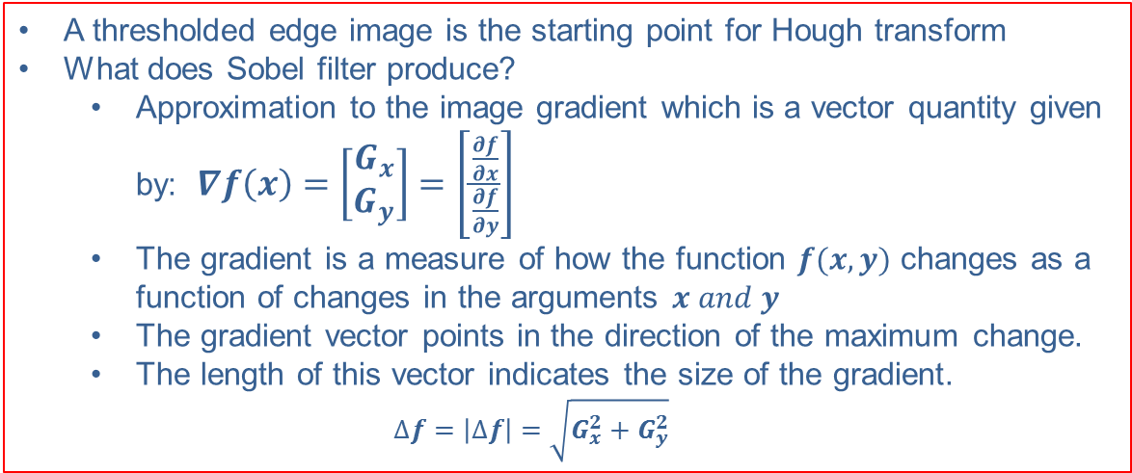
Recap: Calculating gradient
A thresholded edge image is the starting point for Hough transform
What does Sobel filter produce?
Approximation to the image gradient which is a vector quantity given by: $∇f\left(x\right)=\left[\begin{matrix}G_{x} \\ G_{y}\end{matrix}\right]=\left[\frac{\frac{∂f}{∂x}}{\frac{∂f}{∂y}}\right]$
The gradient is a measure of how the function $f(x,y)$ changes as a function of changes in the arguments $x and y$
The gradient vector points in the direction of the maximum change.
The length of this vector indicates the size of the gradient.
$$∆f=\left|∆f\right|=\sqrt{G_{x}^{2}+G_{y}^{2}}$$

Slide 10
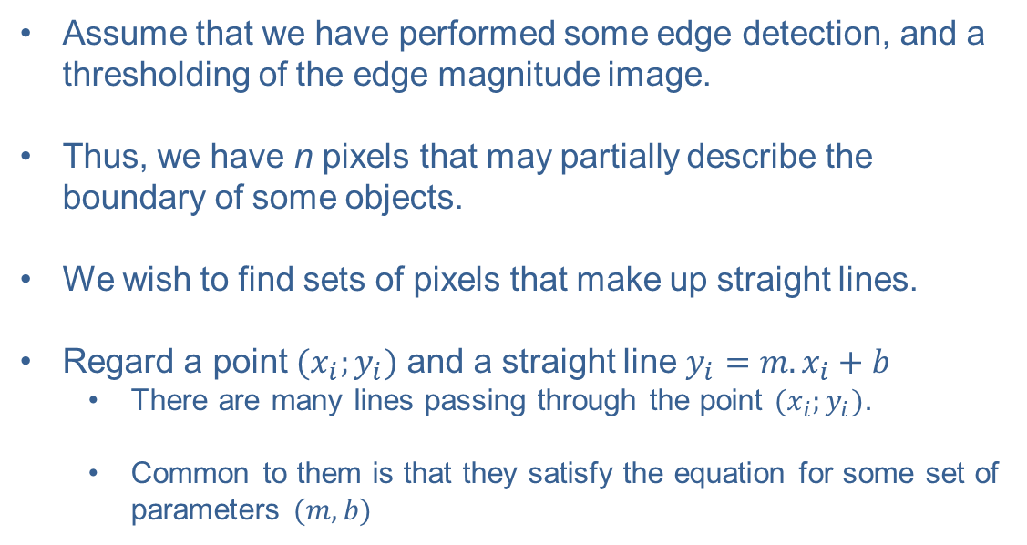
Hough Transforms
The basic idea
Assume that we have performed some edge detection, and a thresholding of the edge magnitude image.
Thus, we have n pixels that may partially describe the boundary of some objects.
We wish to find sets of pixels that make up straight lines.
Regard a point $(x_{i};y_{i})$ and a straight line $y_{i}=m.x_{i}+b$
There are many lines passing through the point $(x_{i};y_{i})$.
Common to them is that they satisfy the equation for some set of parameters $(m,b)$

Slide 11












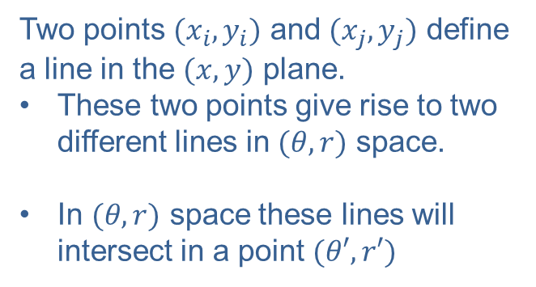
Hough Transforms
Two points $(x_{i},y_{i})$ and $(x_{j},y_{j})$ define a line in the $(x,y)$ plane.
These two points give rise to two different lines in $(θ,r)$ space.
In $(θ,r)$ space these lines will intersect in a point $(θ′,r′)$
$$x→$$
$$θ$$
$$r$$
$$(x_{j},y_{j})$$
$$y→$$
$$(x_{i},y_{i})$$
$$θ^{′}$$
$$θ→$$
$$x_{j}cosθ+y_{j}sinθ=ρ$$
$${\text{r}}^{′}$$
$$x_{i}cosθ+y_{i}sinθ=ρ$$
$$r→$$

Slide 12
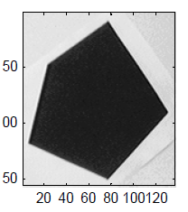
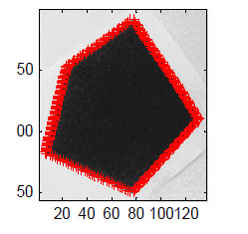
Hough Transforms
Loaded Image
Image with detected edges

Slide 13
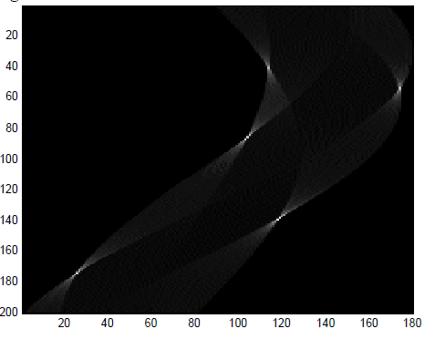
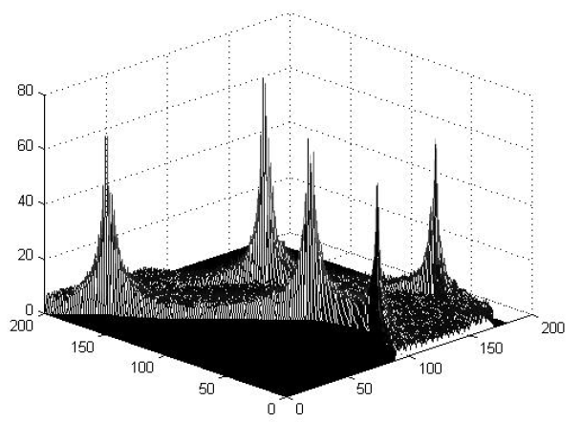
Hough Transforms
Vote histogram.
Vote histogram in 3D.

Slide 14
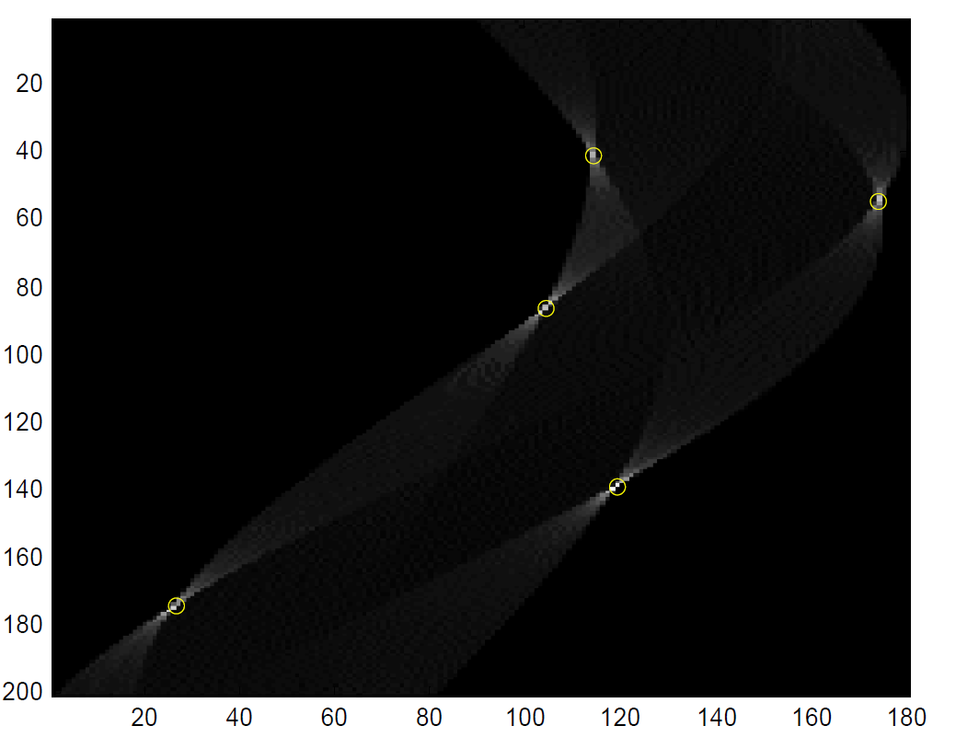
Hough Transforms
The detected lines marked with ‘o’ on the vote histogram.

Slide 15
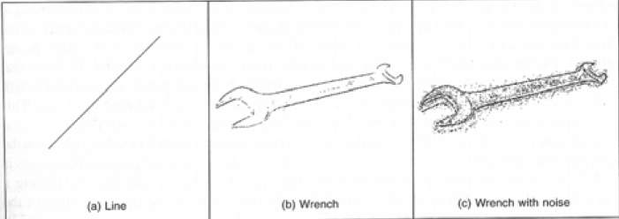
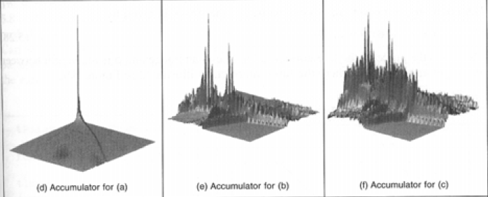
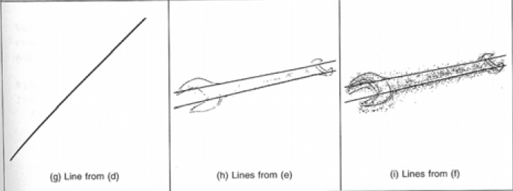
Hough Transforms
Example – images and accumulator space
Thresholded
Edge images
Visualizing the
Accumulator space.
The height of the
peak will be defined
by the number of
pixels in the line.
Note how noise effects the accumulator.
Still with noise, the largest peaks correspond to the major lines.
Thresholding the accumulator space and superimposing this onto the edge image.

Slide 16
An example using the Hough line detector: Click here.
An example using the Hough circle detector : Click here.
Another example using the Hough circle detector can be found at: opencv_source_code/samples/cpp/houghcircles.cpp or here for detecting objects.

Slide 17
// Finds the intersection of two lines, or returns false.
// The lines are defined by (o1, p1) and (o2, p2).
bool intersection(Point2f o1, Point2f p1, Point2f o2, Point2f p2,
Point2f &r)
{
Point2f x = o2 - o1;
Point2f d1 = p1 - o1;
Point2f d2 = p2 - o2;
float cross = d1.x*d2.y - d1.y*d2.x;
if (abs(cross) < /*EPS*/1e-8)
return false;
double t1 = (x.x * d2.y - x.y * d2.x)/cross;
r = o1 + d1 * t1;
return true;
}
More examples

